Slide 1
CAV RP Customization
Presented by: David Loar
Notes:
USS H. S. Truman (CVN-75)

Slide 2
Appearance
Home Page Tiles Layout
Creating Home Page Group
Adding Custom Groups
Resetting Home Page Display
Limiting Page Display
Summary and History Report Custom Layout
Summary and History Report Public Layouts

Slide 3
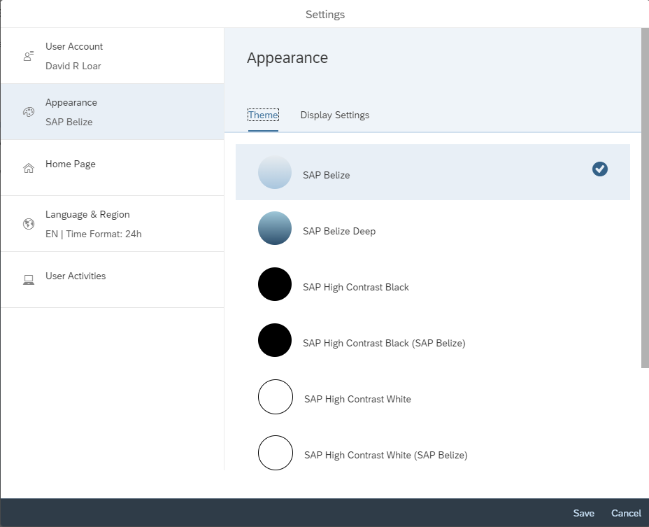
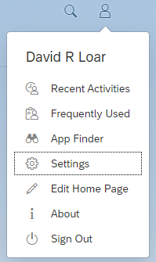
CAV RP Appearance
In the top right corner of the CAV RP screen navigate to the profile icon and left click on the icon. Once clicked, the user will be presented with the below selection:
A box will appear in the center of the screen. The user should select “Appearance” on the left side. They will be presented with 8 different appearance options.
The user should select “settings”.

Slide 4
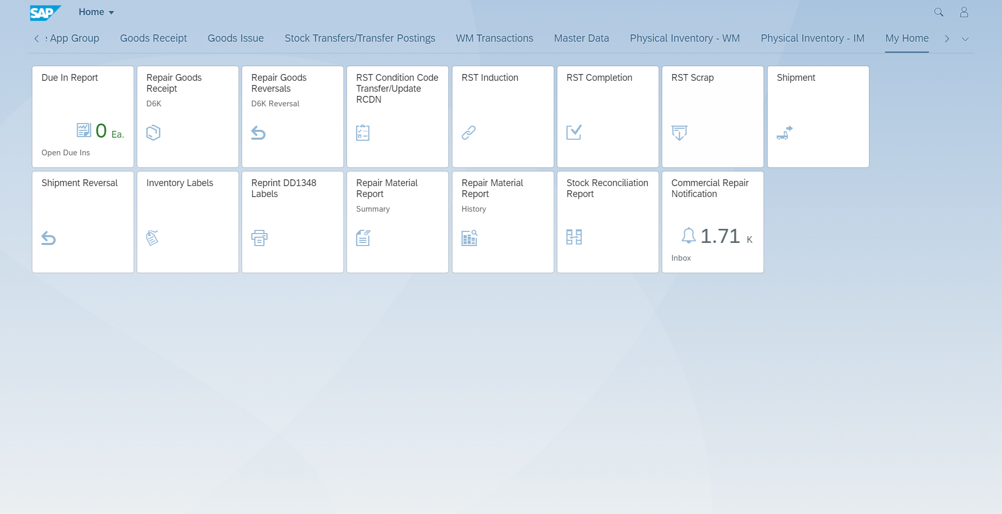
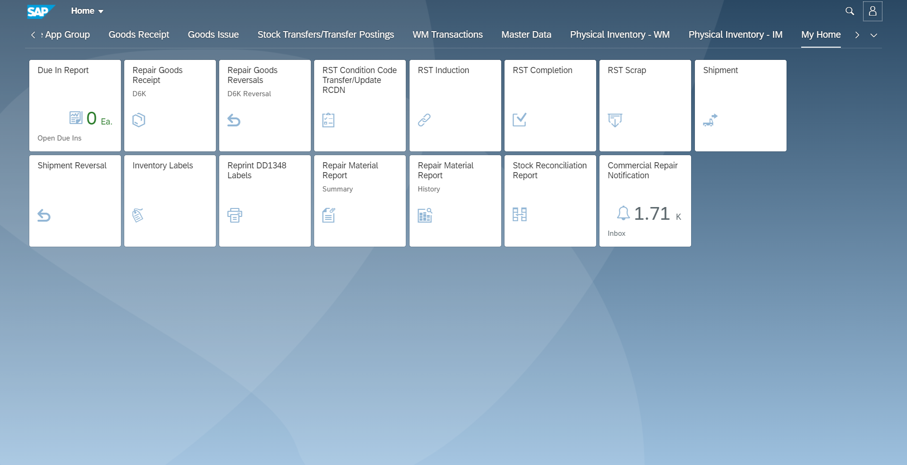
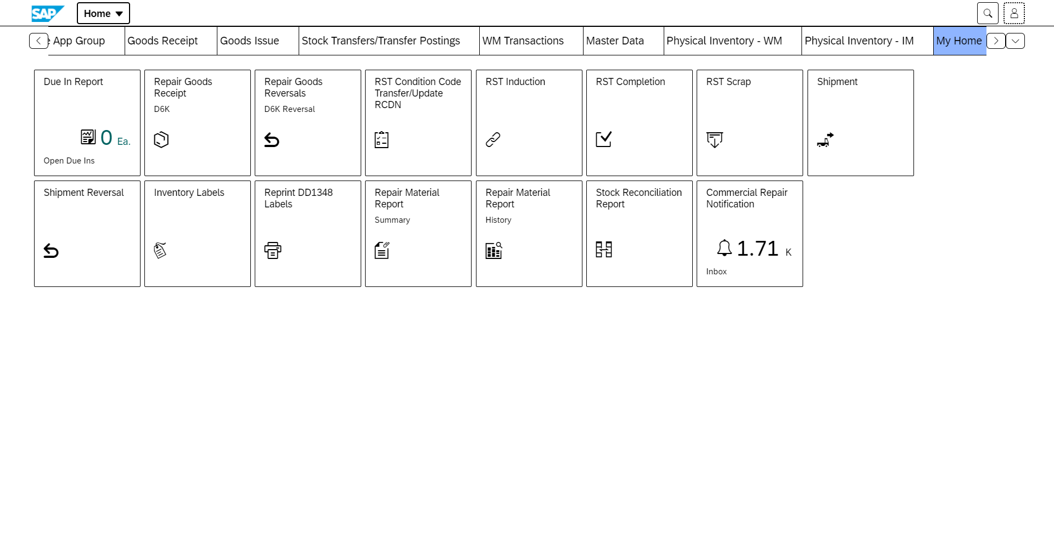
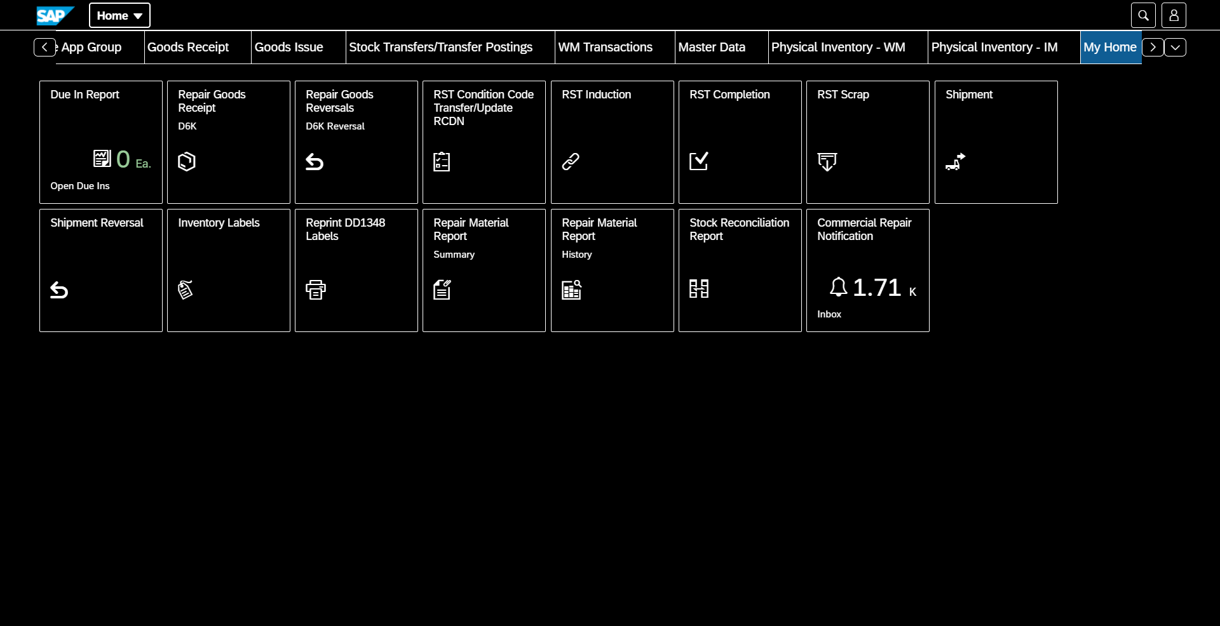
Different Appearances
SAP Belize
SAP Belize Deep
SAP High Contrast White
SAP High Contrast Black

Slide 5
Home Page Tiles Layout
The user can move tiles as they please. To move tiles, all you need to do is drag and drop.

Slide 6
Creating A Home Page Group
A custom home page group can be created to store all your favorite tiles in one place.

Slide 7
Adding Custom Groups
Custom groups can also be added to group similar tasks together.

Slide 8
Resetting Home Page Display
A user can always reset a groups tiles in the Edit Home Page function.

Slide 9
Limiting Page Display
If a user is overwhelmed by the number of tiles displayed on the page, they can limit the page display to only show one group at a time.

Slide 10
Summary and History Report Custom Layout
To create a custom layout in the history and summary report, click the gear icon on the right side of the screen. Select the desired columns on the left side and then position them in the desired order by using the arrow on the top right.

Slide 11
Summary and History Report Public Layouts
The recommend public layouts for the Summary and History Reports are “N85 Recommended Summary Layout” and “N85 Recommended History Layout”.

Slide 12
Questions?

